Slide 1
HiAI Foundation Analysis
DTSE team 11/10/2020

Slide 2
Table of Contents
Background - Purpose and Goal of this report
What is HiAI?
HiAI Foundation Analysis
HiAI Analysis using Mobilenet
ASR and OCR model limitation
Insights

Slide 3
Background
HiAI Foundation is one of key HMS Core solutions that would provide App developers a tool that gives better performance of executing inference models using Huawei Kirin processors in Huawei devices.
The purpose of this report is to demonstrate how HiAI foundation tool is used and how to develop an app based on couple of well-known inference models such as mobilenet, OCR, and ASR running under Huawei devices.
In this report, we compared xx test cases after running the same model either using an Android ML tool or a HiAI foundation tool and then analyzed the results.
At the end, we provided the benefits and roadmap of using HiAI foundation.

Slide 4
What is HiAI?

Slide 5
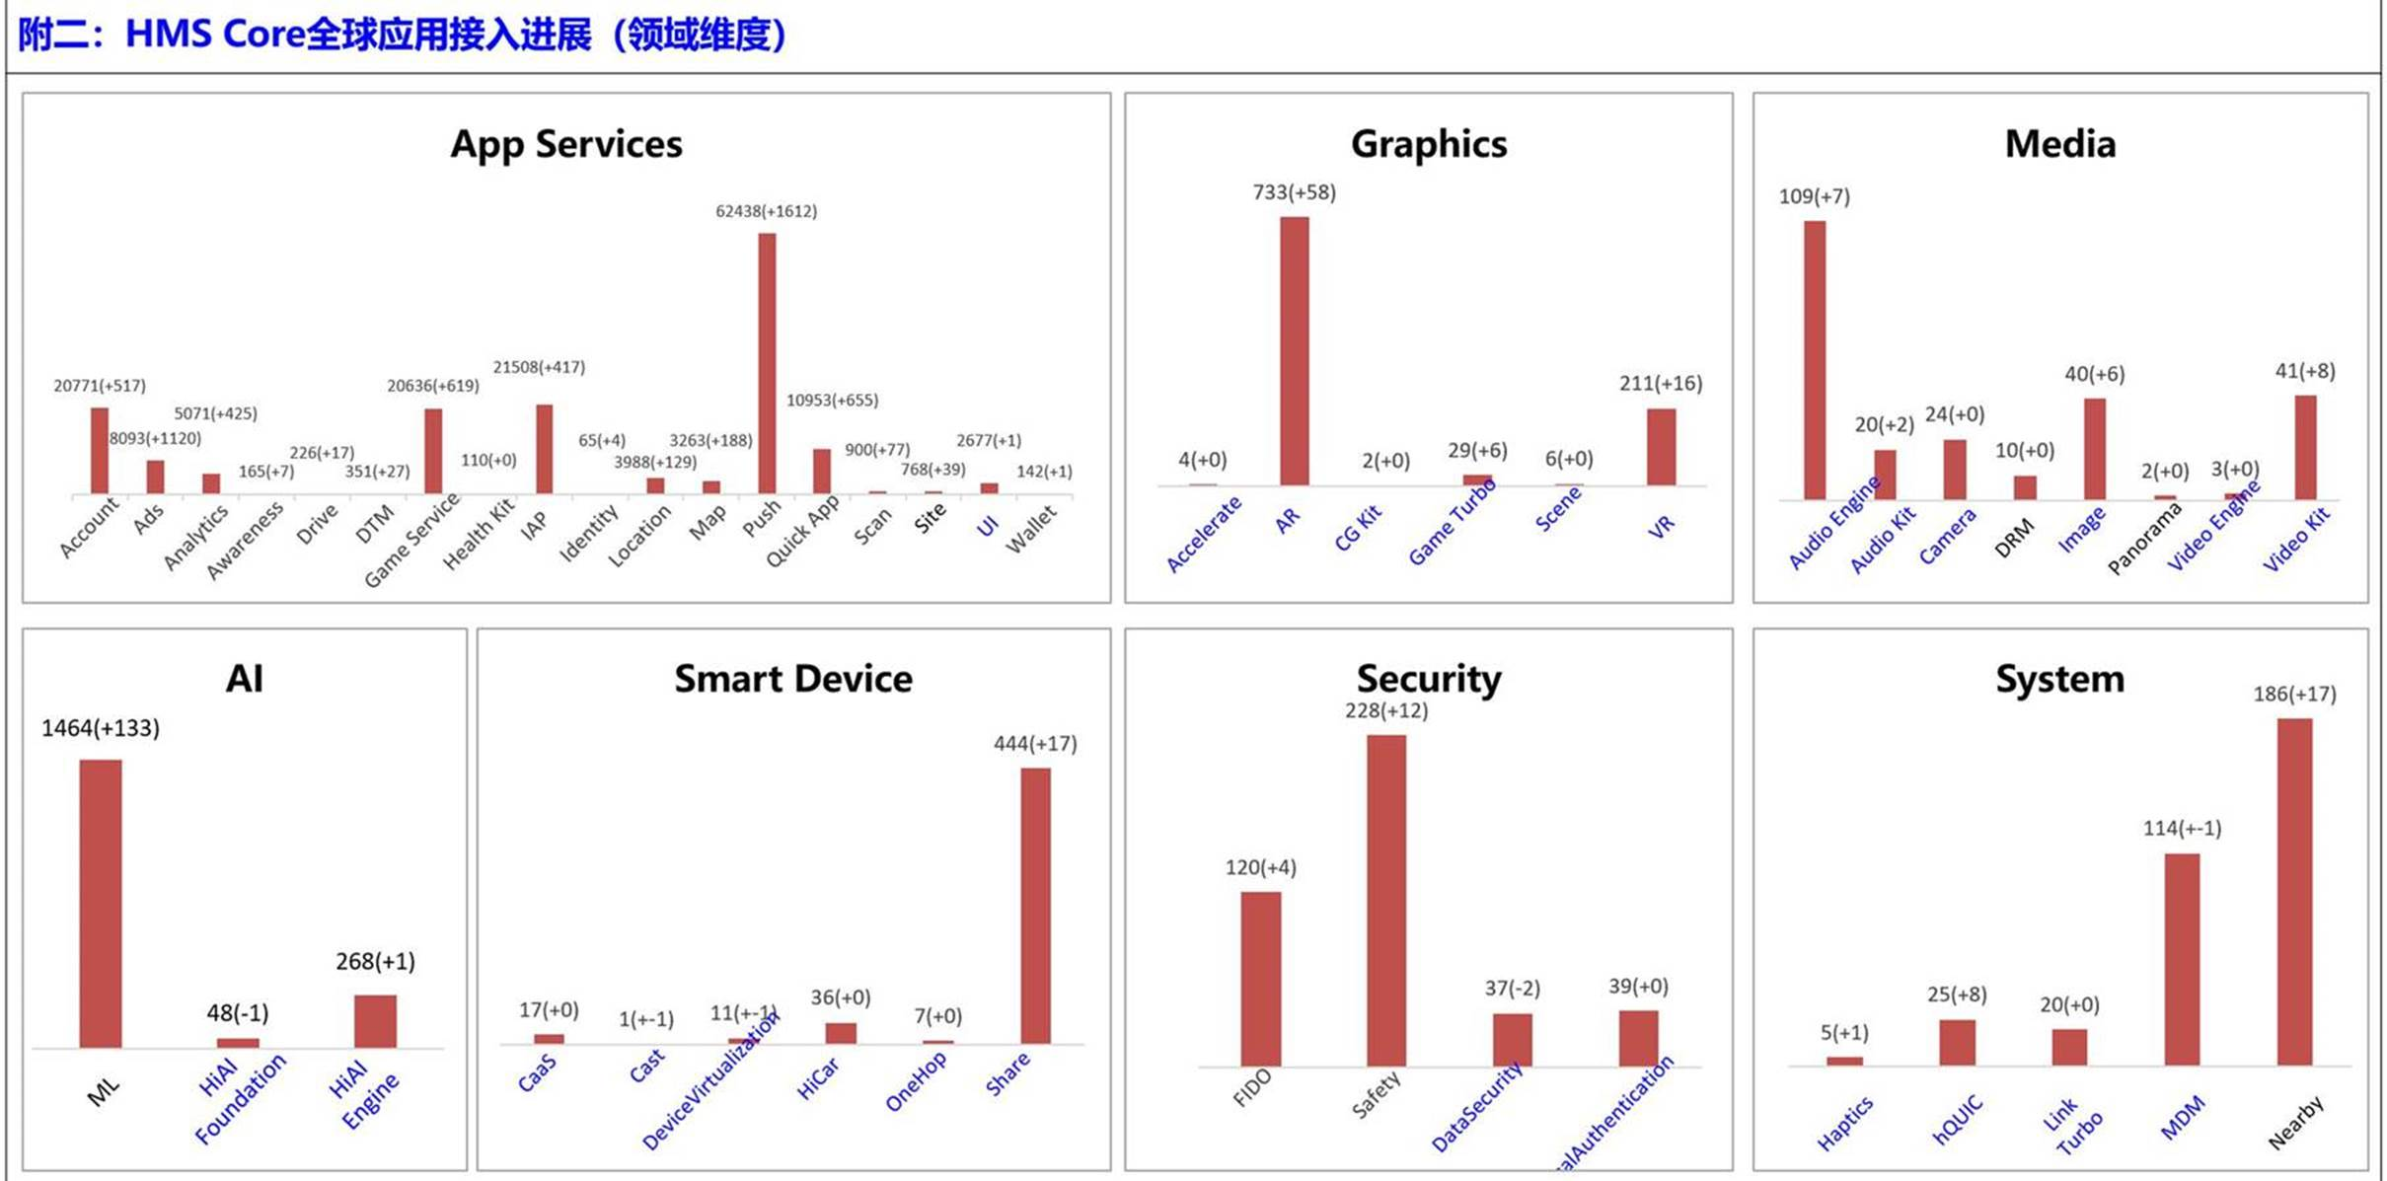
HMS Core solutions : AI is widely used
Three HMS Core AI solutions

Slide 6
Comparison between Huawei ML vs Google ML
Parameter | ML Kit | HiAI Engine | HiAI Foundation | Google ML Kit | Android NN API
Model | Default Model | Default Model | Custom Model | Default Model Custom Model | Custom Model
Resources | Cloud Device No Choose | Device Choose CPU or NPU | Device Choose CPU or NPU | Cloud Device | Device CPU or NPU
Offline/Online | Both | offline | Offline | Both | Offline
Cost | Free | Free | Free | Cloud Not Free $1.5/1000 API calls | Free
Privacy | Limited Data may leave the device, additional precautions may be necessary | User Controlled User data never leaves the device | User Controlled User data never leaves the device | Limited Data may leave the device, additional precautions | User Controlled User data never leaves the device
ML model Platform | NA | NA | Tensorflow Liter Pytorch, Caffe, ONNX | Tensorflow Lite | Tensorflow Lite, Pytorch, etc.
Development Time | Low effort | Medium effort | High Effort Locked-in to Huawei NPUs | Low/Medium Effort | Very High Effort Not Locked-in to any processors or vendors

Slide 7




HUAWEI HiAI：an On-Device AI open platform
IDE
HiAI Service
Service Capabilities Openness
Efficient Business Support
HAG (Huawei App Gallery) Service
HiAI Engine
App Capabilities Openness
Rich Scenario-Based Capabilities
Able to select CPU or NPU for inference
Complete
Development
Toolkits
HiAI Foundation
Chip Capabilities Openness
Accelerate NPUs to optimize device performance
Support Tensorflow Lite,

Slide 8






HiAI Engine Solutions in Overseas market
HUAWEI HiAI Engine: Various Out-of-the-box AI Capabilities
Mostly focused on Computer Vision (CV) and ASR is coming in the future
The source of algorithm is not known so that it is not clear what HiAI foundation can support.
Text Recognition
Image Recognition
Facial Recognition
Video Technology
Code Recognition
Body Recognition
General Text Recognition
Table Recognition
Document Converter
Aesthetic Score
Image Category Label
Image Super-Resolution
Scene Detection
Document Skew Correction
Character Image Super-Resolution
Portrait Segmentation
Image Semantic Segmentation
Facial Comparison
Face Detection
Face Parsing
Face Attributes
Face Orientation Recognition
Facial Feature Detection
Video Summarization
Code Detection
Pose Estimation
Video Portrait Segmentation
Notes:
We offer out-of-the-box Computer Vision features like Text Recognition, Image Recognition, Facial Recognition and so on. All of these come in our HiAI Engine SDK. By now, HiAI Engine has opened 20+ APIs, in the near future, more capabilities will be gradually released. Later on, I will introduce them in details.

Slide 9
HiAI Foundation Analysis

Slide 10
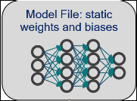
Overview of HI AI Integration
Development
TensorFlow
HIAI
Model
Conversion
Tools
Offline
Model
APK
Parameter
Integrate
Run-time
Input data
Offline Model
Output data
Pre-Process
Binding (HIAI Compatible)
Post-Process
Binding
(HIAI Compatible)
Load
NPU

Slide 11
How to develop Mobilenet using tensorflow vs Huawei OM tools
Trained Tensorflow Model (mobilenet model)
Trained Tensorflow Model (mobilenet model)
Tensorflowlite model convertor (.tflite)
HiAi model convertor (.om)
Android Device
Huawei Device
Android App
Android App
Java API
Java API
C++ API
C++ API
Interpreter
Interpreter
Kernel
Kernel
Android Neural Networks API
HiAi Engine
CPU/GPU/NPU Chip
CPU/GPU/Kirin Chip

Slide 12
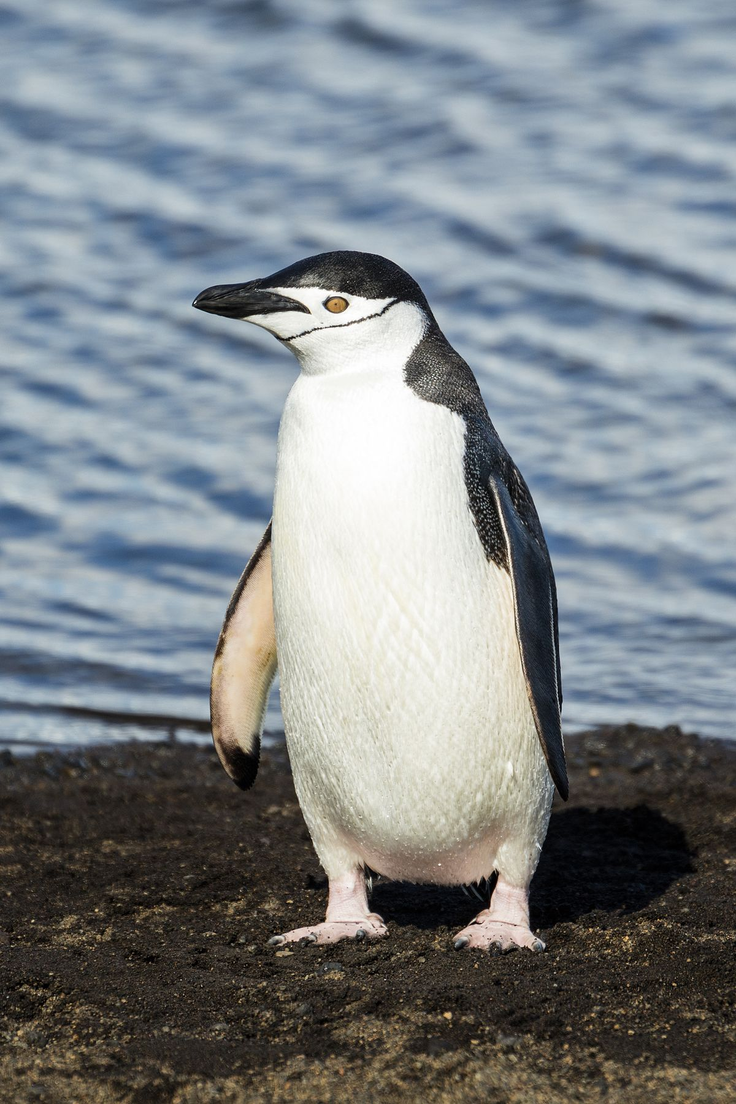
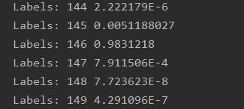
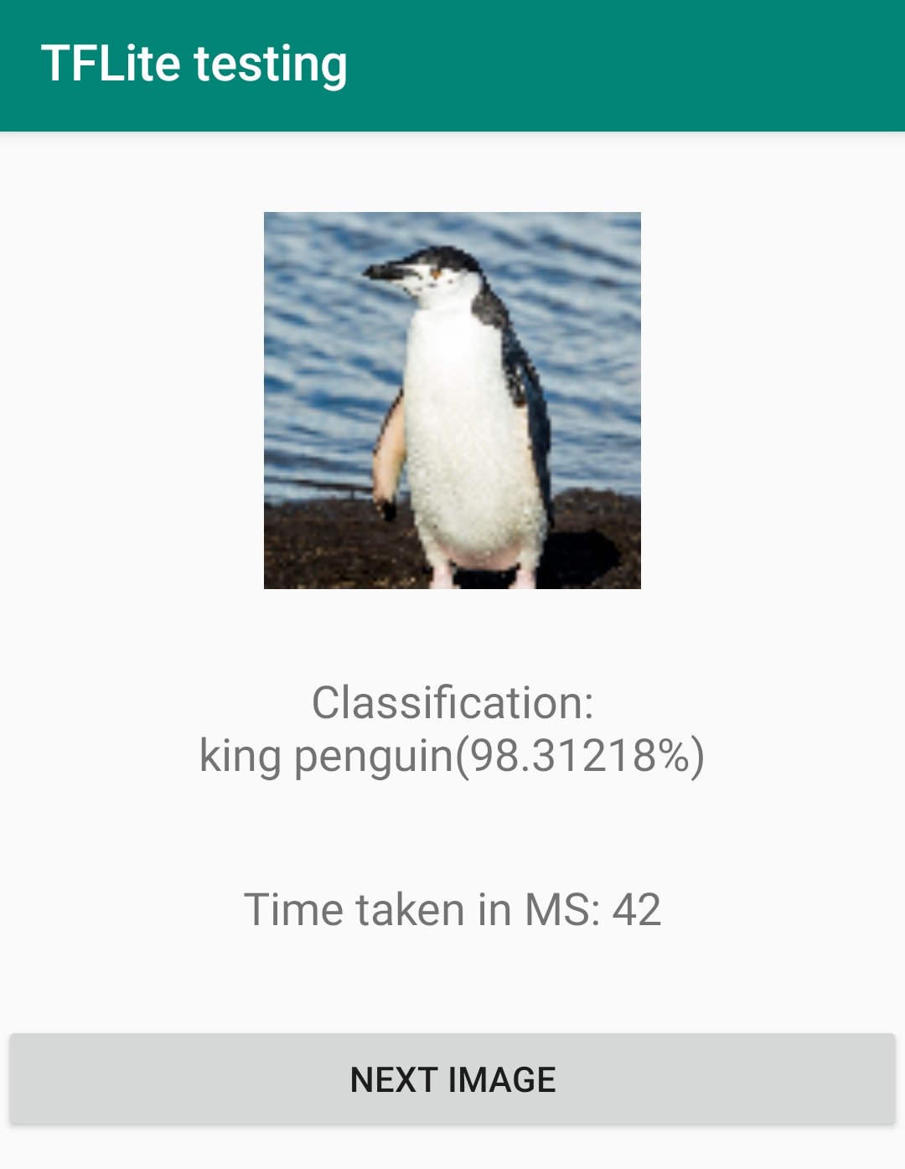
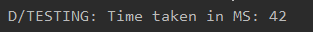
How to run Mobilenet using Android Device and Tflite
Raw data: original image, .jpg or .png, any size
Raw data
Raw output
Processed output
Preprocessing: Select a 224X224 square of pixels around the center. Convert the square image into bitmap. Convert bitmap into bytebuffer in NHWC format
Input to Model: image, 224X224 in size for this specific model, NHWC input format
Converted model: .tflite model. One input at a time, mobilenet supports 1000 image labels
Original model: .pb model (using mobilenet)
Raw Output: A list of 1000 label number to confidence values as text. Performance in time (milliseconds)
Processed output: Highest confidence value with its corresponding label name in text. Performance in time (milliseconds).
12
FUTUREWEI INTERNAL

Slide 13
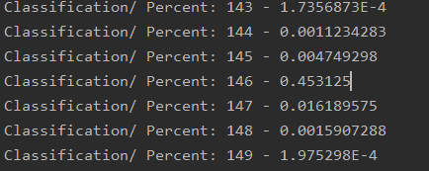
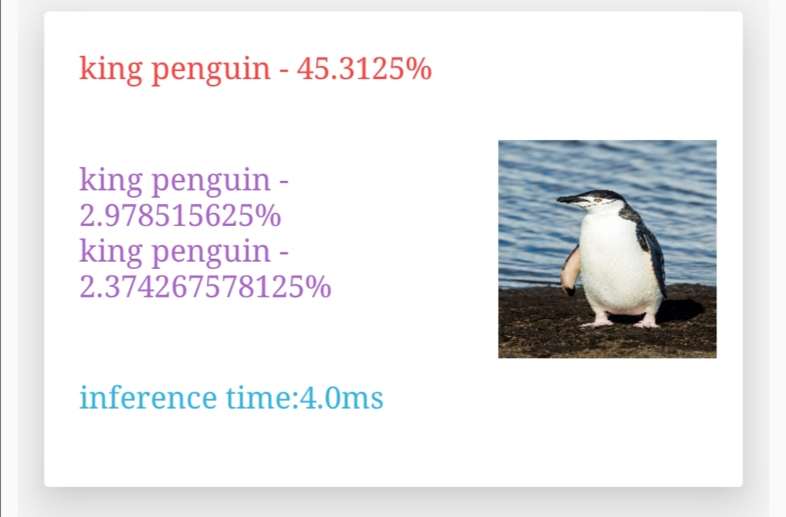
How to run Mobilenet using Huawei Device and HiAI Foundation
Raw data: original image, .jpg or .png, any size
Raw data
Raw output
Processed output
Preprocessing: Select a 224X224 square of pixels around the center. Convert the square image into bitmap. Convert bitmap into bytebuffer in NCHW format
Input to Model: image, 224X224 in size for this specific model, NCHW input format,
Converted model: .om model. One input at a time, mobilenet supports 1000 image labels
Original model: .pb model (using mobilenet)
Performance Comparison between OM vs Tflite
42 ms(previous slide) vs 4 ms
Raw output: A list of 1000 label number to confidence values as text. Performance in time (milliseconds)
Processed output: Highest confidence value with its corresponding label name in text. Performance in time (milliseconds).

Slide 14
Results Table
Using Mobilenet_v2
 | Test 1.a | Test 1.b | Test 2
Client Code | Java (Using Native Android) | Java using NNAPI | Java(HiAI DDK)
ML platform | Tflite | Tflite | HiAI Foundation
model | mobilenet_v2_1.0_224.tflite | mobilenet_v2_1.0_224.tflite | OM(converted from mobilenet_v2_1.0_224_frozen.pb)
model size | 13651KB | 13651KB | 6881KB
Input data | 104 different images | 104 different images | 104 images, all different
Output | N/A | Classified as king penguin | N/A
Device | Honor V30 | Honor V30 | Honor V30
GPU Performance | 18 ms (over 104 images) | N/A | N/A
NPU | N/A | 41ms** | Average Speed: 3.40 ms
Calculated Accuracy | 67.79% | 66.83% | 72.60%

Slide 15
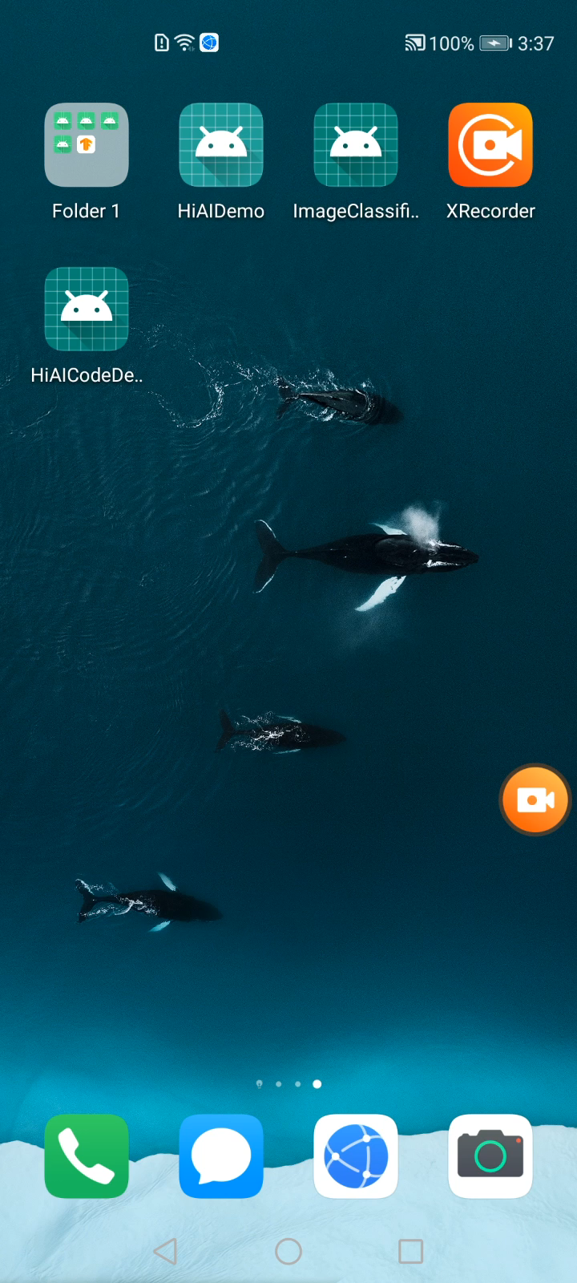

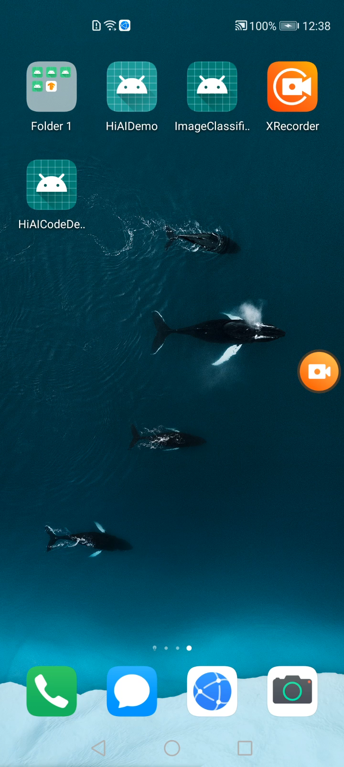
Tflite Demo. Test case 1.a
Tflite Demo. Test case 1.b
HiAi Demo. Test case 2

Slide 16
Analysis
 | Tflite (Tested with 104 images) | HiAi (Tested on 104 images) | MobilenetV2 tflite base (5k minival testing set)
Top 1 accuracy: | 67.79% (Hand Calculated) | 72.60% (Hand Calculated) | 71.8% (From google)
Average Time taken per image: | 18 ms (on GPU) | 3.40 ms (on NPU) | 6.2 ms (on GPU)
Some use case:
Image organization
Expect 100s of images, automatically tagging images and categorizing them according to similarities.
With current expectations on 100 images
Tflite: ~1.8 seconds
HiAi: ~0.340 seconds
Store product discovery
Expect 1000s of images, comparing search image to catalogue of available wares to bring up correct product in additional to similar wares
With current expectations on 1000 images
Tflite: ~18 seconds
HiAi: ~3.40 seconds
Development time:
Going back to slide 12 and 13, you see the same number of steps to be taken for Tflite and HiAi
Developing with tflite or HiAi will take about the same time
Notes:
Over the course of the tests we have obtained times for CPU, GPU, and NPU
With mobilenet_v1 on a phone, using Tflite, CPU is around 40-50ms
Generally, GPU is 20-30ms faster at 22-26 ms
Testing on Kirin NPU, the average time is 3-5 ms, 5 times faster
Top 1 Accuracy for each model from benchmark:
Mobilenet_v2: 71.8%
Mobilenet_v1: 71.0%
The HiAi version are close to expected performance. Deviation can be due to sample size and calculation error.
https://arxiv.org/pdf/1810.01109.pdf

Slide 17
ASR and OCR
We tried to run known open source of ASR and OCR using HiAI but could not make it work.
Not supported Operators was the major reason.
We need to convince CP, but we can’t do so as Foundation does not support the functions needed for ASR and OCR
Can software development team help, help with benchmarking

Slide 18
Huawei NN Operator VS Tensorflow NN Operator
Huawei Supported NN Operators | Tensorflow Supported NN Operators | Tensorflowlite Supported NN Operators
24 | 121 | <116* (tflite conversion merges some of the NN operators, 5 are often removed)
Huawei Supported NN Operators
tf.nn.atrous_conv2d | tf.nn.conv2d_transpose | tf.nn.l2_normalize | tf.nn.relu6
tf.nn.avg_pool | tf.nn.fractional_avg_pool | tf.nn.leaky_relu | tf.nn.selu
tf.nn.bias_add | tf.nn.fractional_max_pool | tf.nn.log_softmax | tf.nn.softmax
tf.nn.bidirectional_dynamic_rnn | tf.nn.fused_batch_norm | tf.nn.lrn | tf.nn.softplus
tf.nn.conv1d | tf.nn.depthwise_conv2d | tf.nn.max_pool | tf.nn.softsign
tf.nn.conv2d | tf.nn.elu | tf.nn.relu | tf.nn.static_bidirectional_rnn
Unsupported Operators in Test Cases
tf.nn.softmax_cross_entropy_with_logits | tf.contrib.deprecated.scalar_summary | tf.contrib.deprecated.merge_summary | tf.signal.mfccs_from_log_mel_spectrograms | audioSpectrogram
BlockLSTM | TensorArrayV3 | TensorArrayScatterV3 | Enter | LoopCond
TensorArrayReadV3 | TensorArrayWriteV3 | NextIteration | Exit | TensorArraySizeV3
FusedBatchNormV3 | CTCGreedyDecoder | TensorArrayGatherV3

Slide 19
Unsupported ASR Operators
Using Tensorflow Simple Speech Recognition.
https://github.com/nicomon24/tensorflow-simple-speech-recognition
Using DeepSpeech 0.6.0.
https://github.com/mozilla/DeepSpeech/releases/download/v0.2.0/deepspeech-0.2.0-models.tar.gz
tf.nn.softmax_cross_entropy_with_logits | tf.contrib.deprecated.scalar_summary | tf.contrib.deprecated.merge_summary
BlockLSTM | tf.signal.mfccs_from_log_mel_spectrograms | audioSpectrogram

Slide 20
Unsupported OCR Operators
Using SimpleHTR.
https://github.com/githubharald/SimpleHTR
Using Attention OCR
https://github.com/da03/Attention-OCR
TensorArrayV3 | TensorArrayScatterV3 | Enter | LoopCond
TensorArrayWriteV3 | NextIteration | Exit | TensorArraySizeV3
CTCGreedyDecoder | TensorArrayGatherV3 | TensorArrayReadV3
FusedBatchNormV3

Slide 21
HiAI Foundation Insights
It supports only Huawei Kirin devices.
It provides better performance than google tensorflow/tflite solutions.
The solution is not general enough to support known open source solutions in the markets. One of major reasons is the solution would not support certain operators.
The roadmap for pytorch is not provided even though certain CP like MeetKai is using it.

Slide 22
Help from Management and HQ
Roadmap
Support operators or convert to known operators.
Simulator of operators?

